Slide 1
“Try not to become a man of success, but rather try to become a man of value.”. -Albert Einstein
Benjamin Ramirez
Lindsay High School Class of 2014

Slide 2
About Me
My 4 Years of High School at LHS
Clubs
History Club and Christian Club
Sports
Freshman year JV Baseball
3 Years of Basketball (1 Freshmen, 2 JV)
Family
Only Child

Slide 3
Preview
Senior Writing (7 Rhetorical Modes)
Journals
Job Shadow
Visual Representation

Slide 4
Journals
Most important month of journals?
The most important month of my journals was December
Where did this series of journals get me?
It made me come to the realization of all of the hard work that I put in each and every month.

Slide 5
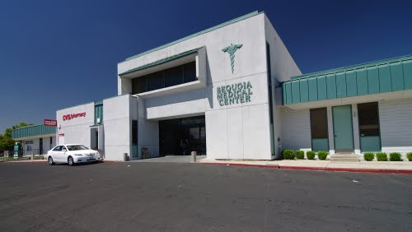
Job Shadow
Who did I job shadow?
Khanh Do
What does this job require?
Ethics
Patience
Education
What kind of education is necessary?
PharmD. Degree
Internships
Would I work here?
I currently had the desire to pursue a job in the Pharmacy field

Slide 6
Research Paper
Why did I choose religion?
I was interested in this topic because I have some background knowledge of this topic
Wanted to choose a topic that I would most enjoy
What knowledge did I gain from writing these essays?
I learned how religion is expressed and viewed by many ethnicities globally

Slide 7
Visual Rep

Slide 8
After High School..
2 Years at a University
Complete my pre-requisites for Pharmacy School
Pharmacy School- UCSF
4 years of pharmacy school
Obstacles
Finances
Studying
Commitment for Success

Slide 9
Thank You!
I appreciate the time that you took to interview me on this important and special day.

